Slide 1
FIRE RESISTING MATERIALS USED IN BUILDING

Slide 2
THE VARIOUS FIRE RESISTING MATERIALS USED IN A COMMON BUILDING ARE :
DOOR
WALL
FLOOR
PAINTS
STONE
BRICKS
TIMBER
GLASS
CONCRETE
CAST-IRON
ASBESTOS CEMENT

Slide 3
FIRE RESISTING PROPERTIES OF COMMON BUILDING MATERIALS

Slide 4
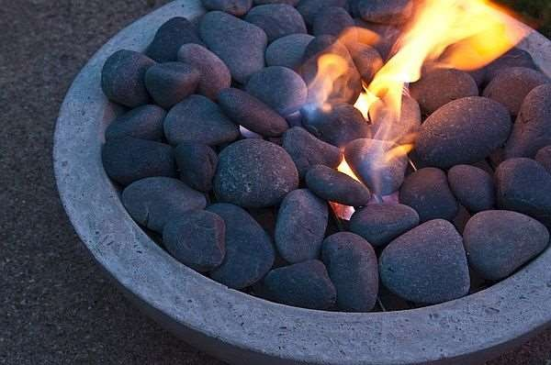
1. STONE
Stone is a bad conductor of heat and it is also a non –combustible building material.
It suffers appreciably under the effect of
heat.
The stone also disintegrate into
small pieces when heated and suddenly cooled.

Slide 5
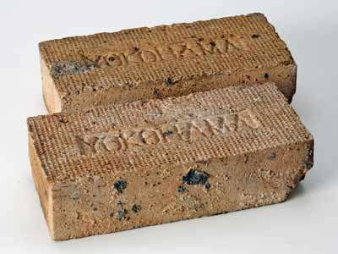
2. BRICKS
A fire brick is a block
of refractory ceramic material used in lining furnaces, klins, and fireplaces.
It is a poor conductor of heat.
It can withstand a temperature of about 1200◦C to 1300◦C.

Slide 6
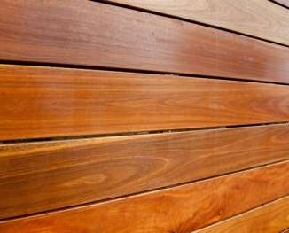
3. TIMBER
As a general rule, the structural elements like TIMBER, ignite & get rapidly destroyed in case of fire.
To make timber more fire- resistant , the surfaces of timber are coated with chemicals like ammonium phosphate & sulphate, & boric acid etc.

Slide 7
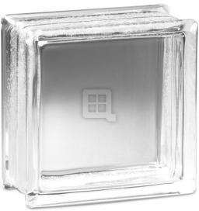
4. GLASS
Glass expansion due to heat is small.
When heated cracks are formed and then suddenly cooled.
Reinforced glass with steel wire is more efficient than ordinary glass.

Slide 8
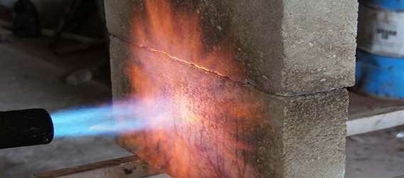
5. CONCRETE
The actual behaviour of concrete in case of fire depends on the quality of cement.
Reinforced concrete structure can resist fire for hours with temperature of 1000▫C

Slide 9
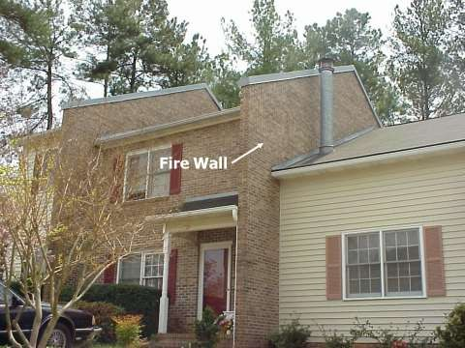
FIRE RESISTANT DOORS & WALLS
A fire door & Walls is a door & wall with a fire-resistance rating.
These are used to reduce the spread
of fire or smoke between compartment.

Slide 10
Fire Protection System in Buildings

Slide 11
The various types of fire protection system are :
AUTOMATIC SPRINKLER SYSTEM
CARBON DIOXIDE SYSTEM
HYDRANTS SYSTEM
DRY CHEMICAL SYSTEM
HALON SYSTEM
WATER SPRAY SYSTEM

Slide 12
EMERGENCY EXIT ARRANGEMENT IN BUILDINGS

Slide 13
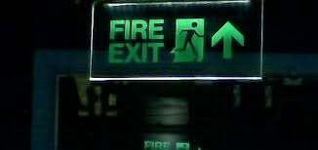
An emergency exit in a building is a special exit for emergencies such as a fire.
The combined use of regular and special exits allows for faster evacuation, while it also provides an alternative if the route to the regular exit is blocked by fire, etc.
These are mainly provided in theatres, hospitals etc.

Slide 14
TYPES OF EXIT
HORIZONTAL – It may be a door – way corridor or a passage to a stairway or to a verandah or a terrace.
VERTICAL – It may be a staircase or ramp but not a lift.

Slide 15
EXIT REQUIREMENTS AS PER NBC OF INDIA :
Every building should be provided with sufficient exit to permit safe escape in the case of fire.
All exits should be free of obstruction.
Adequate illumination ( lighting).
Alarm devices should be installed.
Sprinklers to be provided.

Slide 16
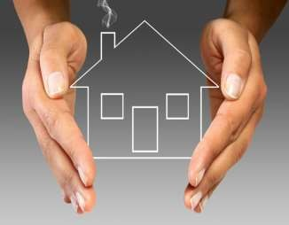
CONCLUSION
Now a days the technologies are developing towards many field and lots of preventing measures from fire has been established.
These are to be utilised by everyone and to be established in all the buildings to protect the life from fire.

